Slide 1



Supply Chain Management: A Tableau-Powered Journey
This presentation explores the journey of optimizing supply chain management using Tableau, a powerful data visualization tool. It covers challenges, data-driven insights, and how Tableau facilitates informed decision-making.

Slide 2
Introduction to Supply Chain Management
Definition
Supply chain management encompasses all the processes involved in planning, sourcing, producing, delivering, and managing the flow of goods and services from raw materials to end customers.
Impor tance
Efficient supply chains are crucial for organizations to remain competitive, reduce costs, and satisfy customer demands. They ensure smooth operations and optimal resource utilization.

Slide 3


Challenges in Supply Chain Optimization
1
2
Disruptions
Unexpected events like natural disasters, pandemics, or geopolitical conflicts can significantly disrupt supply chains.
Volatility
Fluctuating demand, volatile pricing, and fluctuating raw material availability make it challenging to predict and manage supply chains.
3
Complexity
Modern supply chains are complex, with multiple tiers of suppliers, manufacturing
facilities, distribution
centers, and retailers.
4
Sustainability
Organizations face increasing pressure to reduce their environmental
footprint and adopt
sustainable practices across
their supply chains.

Slide 4

Data-Driven Insights with Tableau
Data Visualization
Tableau enables the visualization of complex supply chain data in intuitive and interactive dashboards, providing clear insights.
Real-time Monitoring
Tableau allows real-time monitoring of key metrics, enabling timely identification and response to potential issues.
Trend Analysis
Data visualization tools help identify trends, patterns, and anomalies, supporting informed decision-making and proactive adjustments.

Slide 5

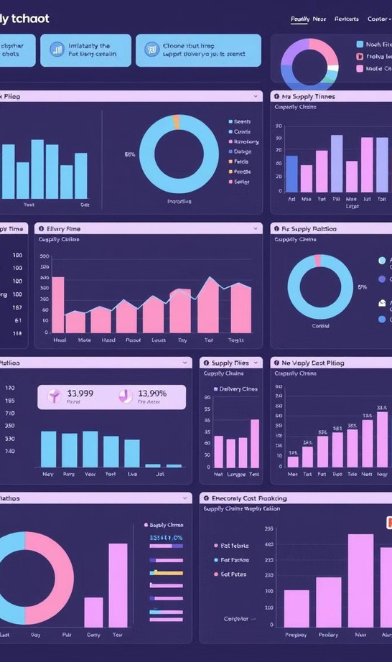
Visualizing Supply Chain Metrics
On-Time Delivery
Track the percentage of orders delivered within agreed-upon timeframes, highlighting potential
delays and bottlenecks.
Inventory Turnover
Measure the efficiency of inventory management by calculating the number of times inventory is sold
and replenished within a period.
Cost Optimization
Analyze and visualize costs across various stages of the supply chain, identifying areas for potential savings and improvements.
Customer Satisfaction
Track customer satisfaction levels based on factors like delivery speed, product quality, and responsiveness to queries.

Slide 6

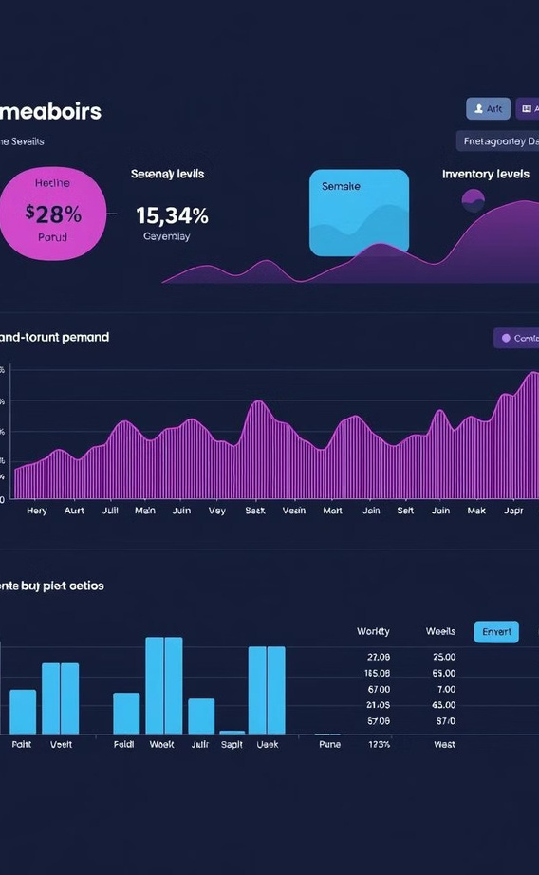
Demand Forecasting and Inventory Management
Demand Forecasting
Tableau allows for accurate demand forecasting using historical data, seasonal trends, and other relevant factors.
1
2
Inventory Optimization
Visualizations help determine optimal inventory levels, minimize stockouts, and reduce excess inventory costs.
3
Safety Stock Management
Tableau facilitates the calculation and visualization of safety stock levels, ensuring sufficient buffer against demand fluctuations.

Slide 7

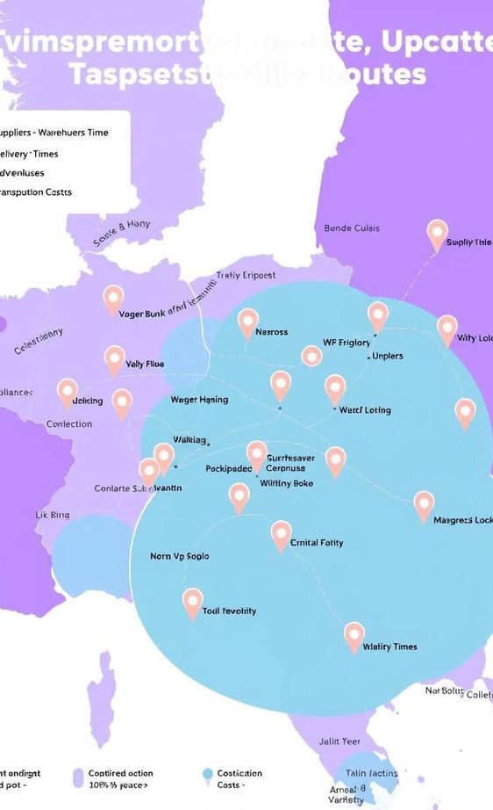
Logistics and Transportation Analy t ics
Route Optimization
Tableau helps analyze and optimize delivery routes, minimizing transportation costs and delivery times.
1
Carrier Performance
Track and compare the performance of different carriers based on factors like on-time deliveries, delivery costs, and customer satisfaction.
2
Transportation Cost Analysis
Visualize transportation costs across various modes of transport, identifying areas for potential savings and improvements.
3

Slide 8

Improving Supply Chain Efficiency
Data-Driven Decisions
Tableau provides the data and visualizations needed to make informed and data- driven decisions.
1
Process Optimization
Identify bottlenecks and inefficiencies in the supply chain, and implement improvements for smoother operations.
2
Enhanced Collaboration
Tableau facilitates seamless collaboration between departments involved in the supply chain.
3
Increased Visibility
Gain greater visibility into all stages of the supply chain, fostering transparency and accountability.
4

Slide 9

Conclusion and Key Takeaways
Data is Key
Leveraging data is crucial for gaining insights and making informed decisions in supply chain management .
1
Tableau empowers
Tableau is a powerful tool that enables organizations to visualize and analyze data, driving efficiency.
2
Optimizing Performance
By implementing data-driven strategies, organizations can optimize performance, enhance efficiency, and achieve better outcomes.
3

Slide 10

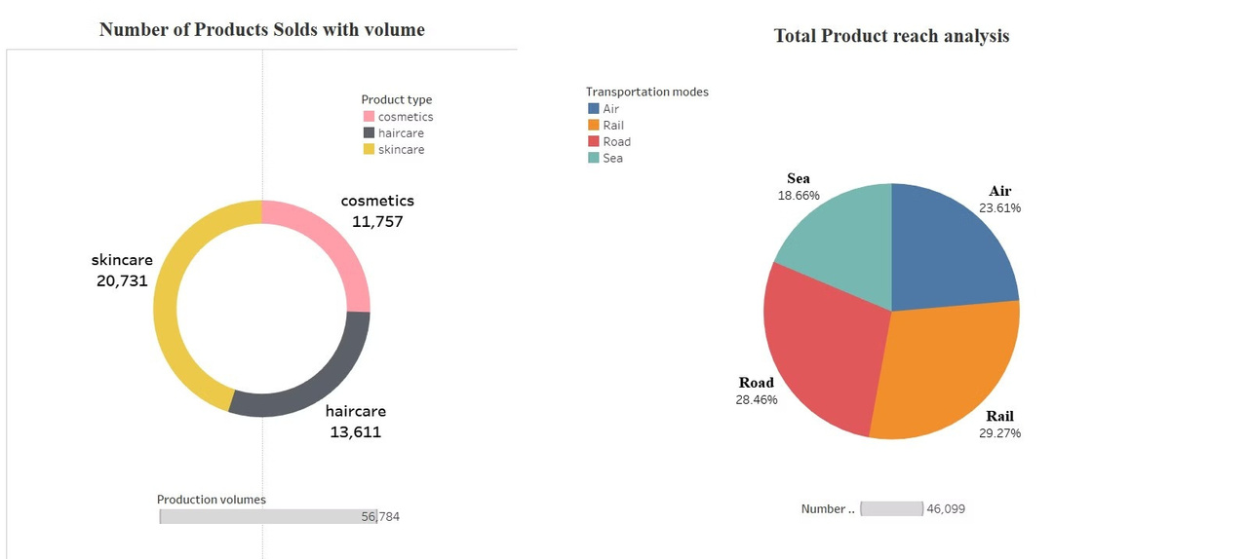
Snapshots of the Project:

Slide 11

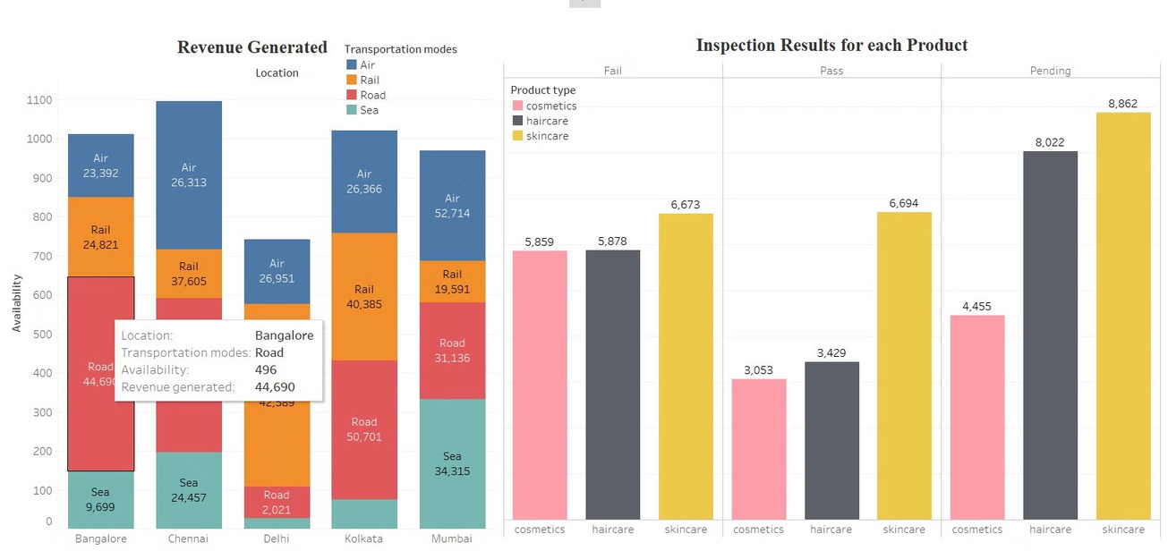

Slide 12
